Slide 1

Serverless App Deployments
adsDDDDD

Slide 2



Agenda
The Journey to Serverless
Serverless Tips & Best Practices
Demos of AWS Lambda, the Serverless Framework, and Azure Cloud Functions

Slide 3
The Journey to Serverless
Chapter 1: Buy a bunch of VMs (IaaS)
Services: AWS EC2, Azure VMs, Rackspace, virtually any cloud provider…
IT WAS GOOD!
Only need to pay for hardware when you’re using it, save money during slow seasons
Able to have servers distributed across different regions for fault tolerance
BUT…
You have to manage the VMs yourself and keep them patched, that’s a real pain!
You need to figure out how and when to scale them up and down!

Slide 4
The Journey to Serverless
Chapter 2: Deploy to Sandboxes (PaaS)
Services: AWS Elastic Beanstalk, Azure Cloud Services/Web Apps/App Service, Heroku, etc
IT WAS GOOD:
Don’t have to worry about patches/updates any more, the cloud provider takes care of that!
BUT:
You still need to configure autoscaling groups and plan how to accommodate traffic bursts and lulls.
Spinning up a new instance isn’t instantaneous, so you need some spare capacity.

Slide 5
The Journey to Serverless
Chapter 3: SPA Front Ends
IT WAS GOOD:
Your SPA front end can just be deployed statically somewhere (S3/Cloudfront) – no need to worry about how it’ll scale (other than cost).
BUT:
You’ve still got that pesky PaaS backend – it’s OK, but…

Slide 6
What If?
We could just deploy our code somewhere, like we do with PaaS sandboxes…
But those sandboxes could be spun up and down automatically, on demand, for any usage scenario?

Slide 8
Serverless Computing (FaaS)!
Abstracts away computing power from the server used to execute it.
Pay per execution, not per server.
Can scale as large as the limit on your credit card, instantaneously, with no brainpower required.

Slide 9
Writing a Serverless Function
Trigger: Something that triggers the function to run (HTTP Request, queue message, blob appearing)
Execute Function: Execute code linked to trigger – usually Javascript, but both AWS and Azure support Python, C# and other languages.
Output: A function doesn’t necessarily need output, but in certain circumstances output needs to be returned to the caller

Slide 10
Triggers
AWS Lambda / Serverless Framework
API Gateway (HTTP)
Streams
S3
Schedule/Cron
SNS
Alexa
IoT
DynamoDB
SES
Cognito
CloudFormation
CloudWatch
Etc…
Azure Functions
HTTP
Blob Storage
Schedule
Queues/Topics
Table Storage/DocumentDB

Slide 11
Pricing
Both AWS & Azure
$0.20/million executions (1 million free)
$0.06/GB-hour of execution time
Request between 128 and 1536 MB
More memory = faster CPU
AWS:
API Gateway: $4/million requests!?!?
Azure:
Hybrid model (run functions code on reserved hardware)

Slide 12
Downsides to Serverless
Pay per request can be an issue depending on pricing (AWS only?)
Functions can’t run forever (max 5 minutes on both AWS and Azure)
“Fanout” pattern can be used to get around this somewhat
No out of the box way to do Websockets
You could technically long-poll if you wanted to pay for it…
Cold Starts!

Slide 13
Serverless Architectures
Microservices (one function per operation – GET, POST, DELETE, etc)
Services (one function per logical group of operations)
Monolithic (one function hosting entire API, defined statically)
GraphQL (one function hosting entire API, defined dynamically)
https://serverless.com/blog/serverless-architecture-code-patterns/

Slide 14
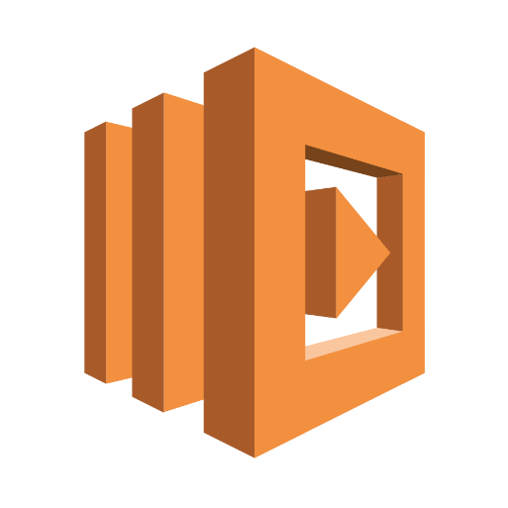
Enough Talking…
DEMO: AWS Lambda

Slide 15
That was fun, but…
How do you manage devops?
What if I want to debug locally?
I want to test before I deploy, right?

Slide 16
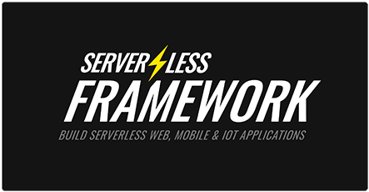
Serverless Framework
Built on top of AWS Lambda & CloudFormation
Write service definitions in YAML, Serverless takes care of deployments, wrangling CloudFormation
Beginnings of Cross-Provider support (Early support for IBM Openwhisk)
Large community, lots of plugins
Local development support (through plugin)

Slide 17
DEMO: Serverless Framework

Slide 18

Azure Functions
Better out of the box dev story (in theory)
Visual Studio project support
Has nicer in-portal function management than AWS
Downsides:
Still feels very beta, even though now GA
Visual Studio support isn’t really that great
Some things HAVE to be configured in-portal

Slide 19
DEMO: Azure Functions

Slide 20

Thank you!

